Slide 1
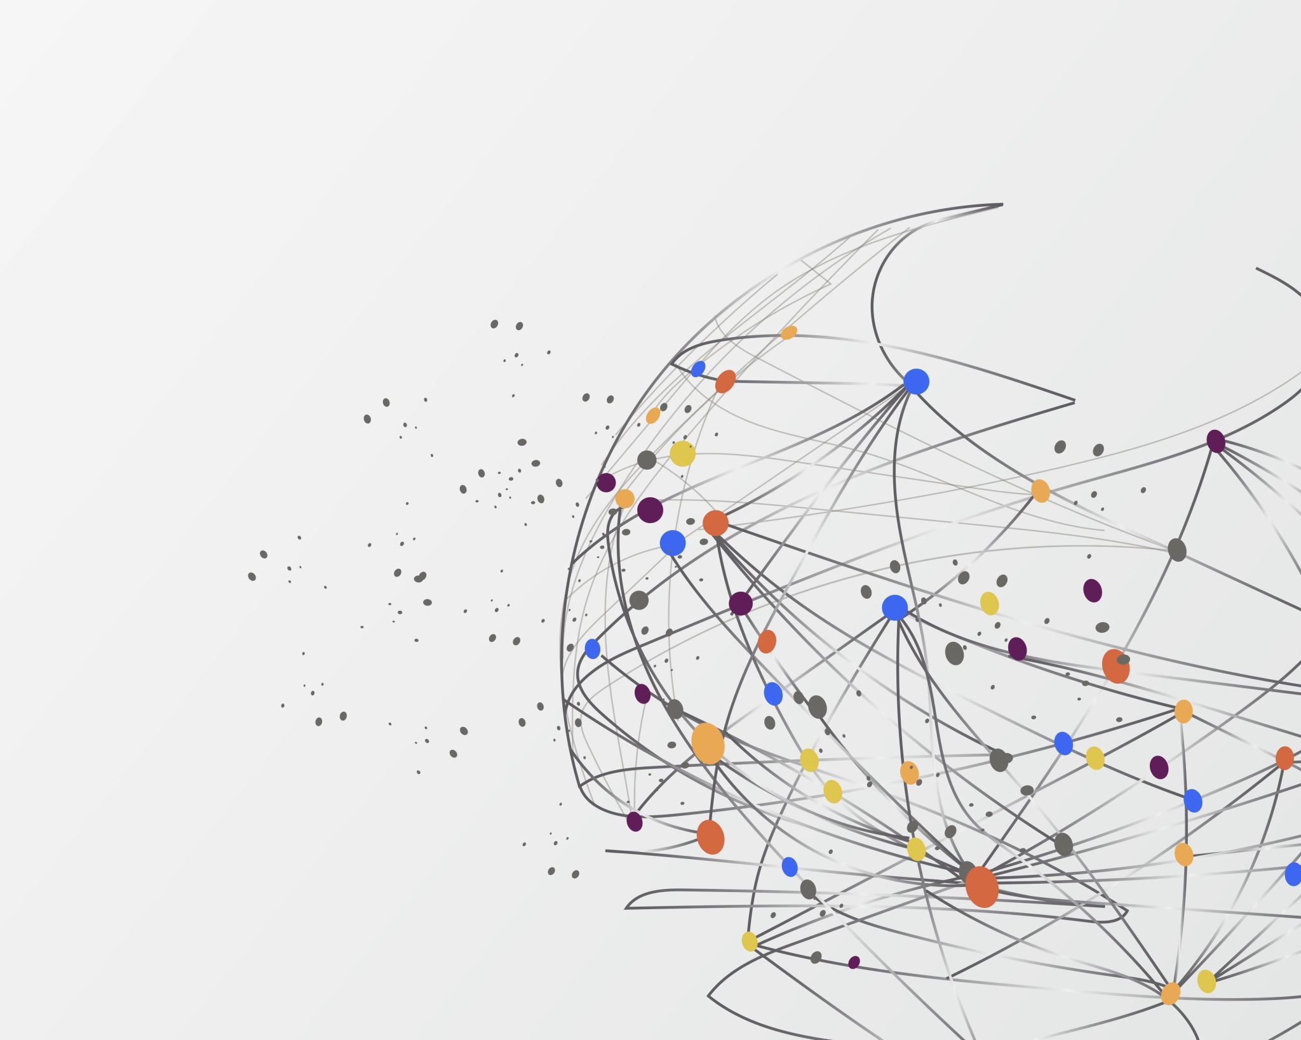
Research Project – Machine Learning using Python
Course: Advanced Topics - Web Dev
Mahfuzur Rahman and Pablo Quintana

Slide 2
Overview
A historical introduction
What is Machine Learning and types of Algorithms
What is a Neural Network and types of Deep Neural Networks
Deep Learning and Computer Vision, tools, and examples
Object Detection Algorithms
Convolutional Neural Networks and how does it work
Demos and activity

Slide 3

Alan Turing
AI – A little history
“On Computable Numbers” (1936)
Describing What Came to be Called the "Turing Machine"

Slide 4
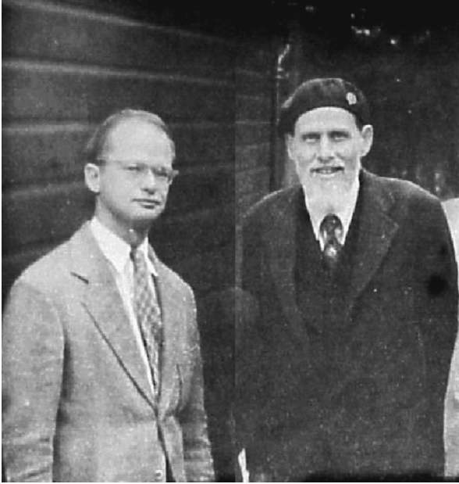
Warren McCullough and Walter Pitts
AI – A little history
“A Logical Calculus of the ideas Imminent in
Nervous Activity” (1943)
The first mathematical model of a neural network

Slide 5
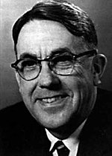
Arthur Samuel
AI – A little history
He popularized the term "machine learning" in 1959
The Samuel Checkers-playing Program was among the
world's first successful self-learning programs

Slide 6
AI Winter and Big Data
AI – A little history
From 1974 to 1980, AI funding declined drastically, making this time known as the First AI Winter.
Interest in AI wouldn't be revived until years later with the advent of expert systems.
This would eventually end with another AI winter from the late 1980s to mid-90s.
After that, advances in computing power and Big data allowed researchers to develop more sophisticated learning algorithms, powering AI until today.

Slide 7
What is Machine Learning?
Is a branch of artificial intelligence.
Gives computers the ability to learn without explicitly being programmed.
Machine learning starts with data — numbers, photos, or text, like bank transactions, pictures of people or even bakery items, repair records, time series data from sensors, or sales reports.
Use supervised, unsupervised, and Reinforcement learning.
Supervised learning uses labeled training data, and unsupervised learning does not. Reinforcement trains machines through trial and error to take the best action by establishing a reward system.
Can be descriptive, meaning that the system uses the data to explain what happened; predictive, meaning the system uses the data to predict what will happen; or prescriptive, meaning the system will use the data to make suggestions about what action to take.
Definitions

Slide 8
ML Algorithms
Supervised Learning
Linear Regression | Stock Price Prediction, Predicting housing prices, Predicting customer lifetime value.
Logistic Regression | Predicting credit risk score, Customer churn prediction.
Decision Tree | Customer churn prediction, Credit score modeling, Disease prediction.
Random Forests | Credit score modeling, Predicting housing prices.
Support Vector Machines (SVMs) | Intrusion detection, email classification, bioinformatics, finance for predicting stock prices
Artificial Neural Network | Computer Vision, Natural Language Processing.
Applications
Unsupervised Learning
K-Means | Customer segmentation, Recommendation systems.
Hierarchical Clustering | Fraud detection, Document clustering based on similarity.
Gaussian Mixture Models | Customer segmentation, Recommendation systems.
Apriori Algorithm | Product placements, Recommendation engines, Promotion optimization.
Artificial Neural Network | Clustering, data dimensionality reduction, and segmentation

Slide 9
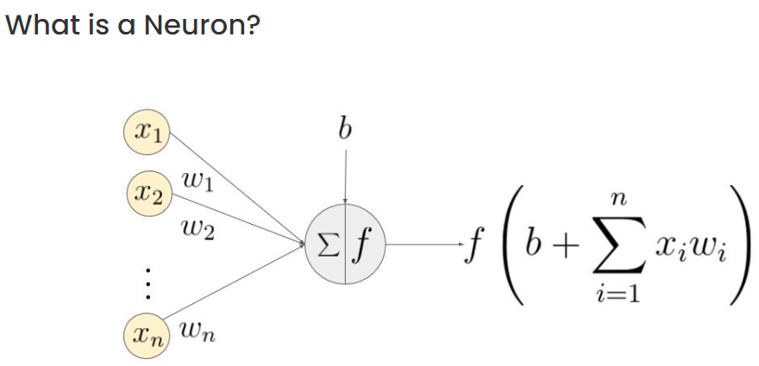
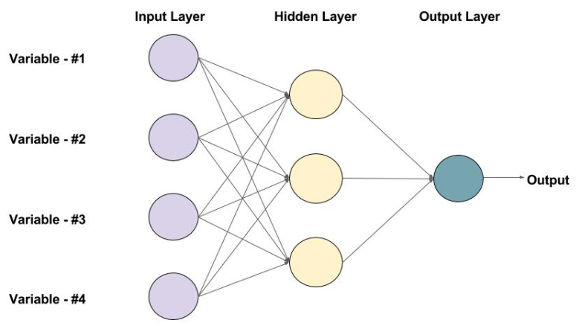
What is Neural Networks?
Neural networks are a subfield of machine learning.
The idea behind neural networks was first born in the 1950s with the perceptron algorithm.
A perceptron is a simplified model of a human neuron that accepts an input and performs a computation on that input.
The output is then fed to an activation function, which decides whether the neuron will “fire” based on the output value.
Using an algorithm known as backpropagation, the neural network can adjust the influence of any particular node in the network, attempting to reduce the errors that the network makes when calculating a final result.
Definitions
Feedforward Network Architectures

Slide 10
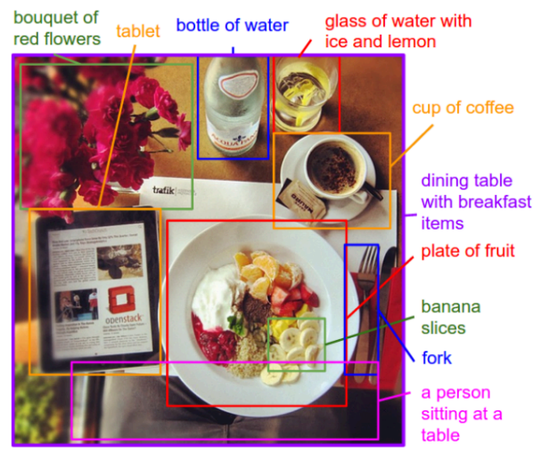
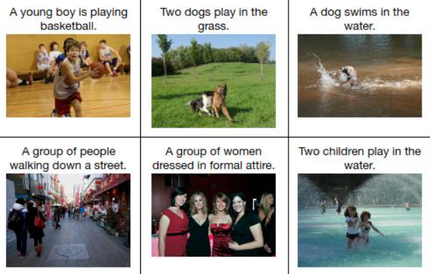
Types of Deep Neural Networks?
Convolutional Neural Networks (CNNs)
Frequently used for the tasks of image classification.
Definitions
Recurrent Neural Networks (RNNs)
strong choice for building up sequential representations of data over time: tasks such as document translation, voice recognition, sentiment analysis, Image captioning, and Natural Language Processing (NLP).
A famous algorithm used is Long Short-Term Memory (LSTM).

Slide 11










Deep Learning and Computer Vision
Computer Vision Applications
Face Recognition | Object Detector
Object Classification | Object Tracking
Medical imaging processing | Autonomous vehicles
Augmented reality | Manufacturing
Python and library tools

Slide 12
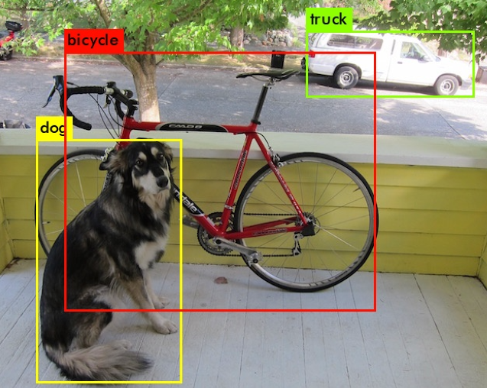
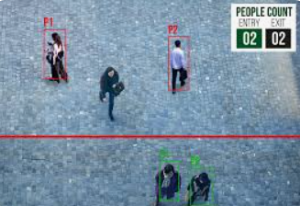
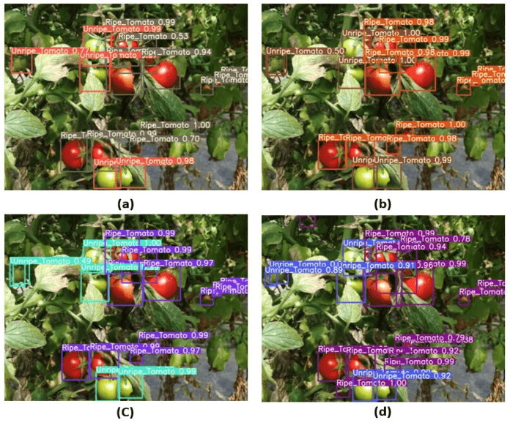
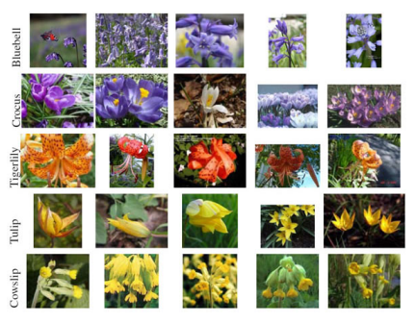
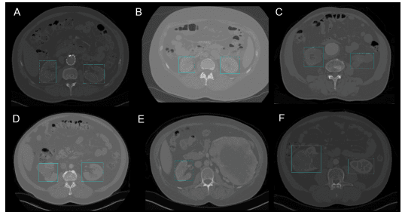
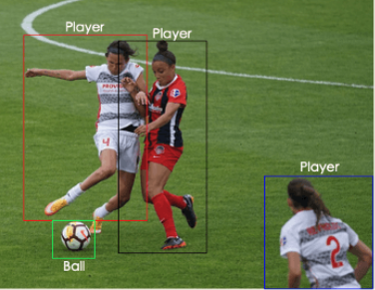
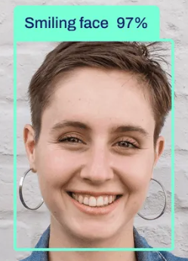
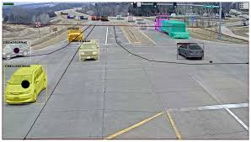
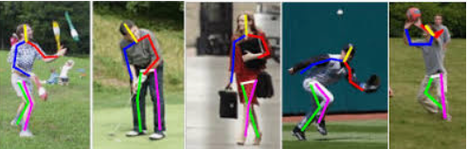
Computer Vision
Application examples

Slide 13
Object Detection
Traditional Object Detection
Type of algorithms
Haar Cascade Classifier (Paul Viola and Michael Jones. “Rapid Object Detection using a Boosted Cascade of Simple Features”. 2001)
Histogram of Oriented Gradients (HOG) (Dalal and Triggs. “Histogram of Oriented Gradients for Human Detection”. 2005)
Deformable Part-based Model (DPM) (Pedro F. Felzenszwalb, Ross B. Girshick, David McAllester and Deva Ramanan. “Object Detection with Discriminatively Trained PartBased Models“. 2009)
Deep Learning Detection
Convolutional Neural Networks (CNN) (Y. Lecun; L. Bottou; Y. Bengio; P. Haffner. "Gradient-based learning applied to document recognition". (1998) . http://vision.stanford.edu/cs598_spring07/papers/Lecun98.pdf)
Region-Based Convolutional Neural Networks (R-CNN) (Ross Girshick, Jeff Donahue, Trevor Darrell, and Jitendra Malik’. “Rich feature hierarchies for accurate object detection and semantic segmentation”. 2014)
Faster R-CNN with Region Proposal Networks (RPN) (Shaoqing Ren, Kaiming He, Ross Girshick, and Jian Sun. “Faster R-CNN: Towards Real-Time Object Detection with Region Proposal Networks”. 2015)

Slide 14
Object Detection
Deep Learning Detection
Type of algorithms
Mask R-CNN (Kaiming He, Georgia Gkioxari, Piotr Dollár, and Ross Girshick. “Mask R-CNN”. 2017)
Feature Pyramid Networks(FPN) (Tsung-Yi Lin, Piotr Dollár, Ross Girshick, Kaiming He, Bharath Hariharan, and Serge Belongie. “Feature Pyramid Networks for Object Detection”. 2017)
You Only Look Once (YOLO) (Joseph Redmon, Santosh Divvala, Ross Girshick, and Ali Farhadi’s. “You Only Look Once: Unified, Real-Time Object Detection”. 2016)
Single Shot Detector (SSD) (Wei Liu, Dragomir Anguelov, Dumitru Erhan, Christian Szegedy, Scott Reed, Cheng-Yang Fu, and Alexander C. Berg. “SSD: Single Shot MultiBox Detector”. 2016)
MTCNN (Kaipeng Zhang, Zhanpeng Zhang, Zhifeng Li, Yu Qiao. “Joint Face Detection and Alignment using Multi-task Cascaded Convolutional Networks”. 2016)
RetinaNet (Tsung-Yi Lin, Priya Goyal, Ross Girshick, Kaiming He, Piotr Dollár. “Focal Loss for Dense Object Detection”. 2018)
YOLOv8 (Dillon Reis, Jordan Kupec, Jacqueline Hong, and Ahmad Daoudi. “Real-Time Flying Object Detection with YOLOv8”. 2023)

Slide 15
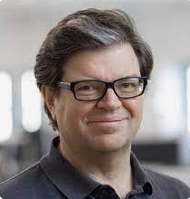
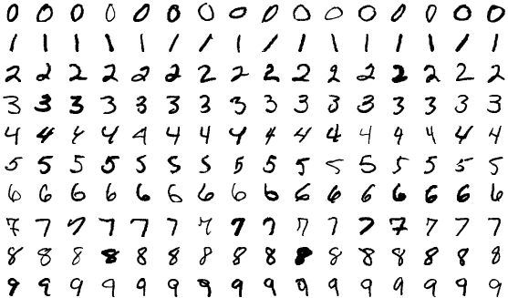
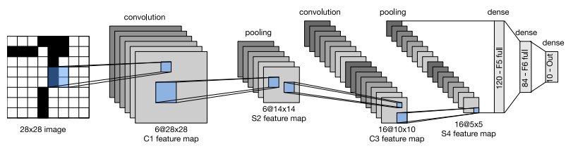
Convolutional Neural Networks
LeNet (1988 – 1994)
First CNN
MNIST database with handwritten code numbers
Yann LeCun

Slide 16
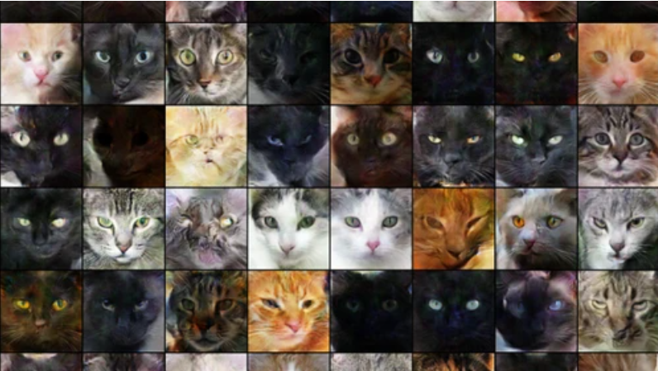
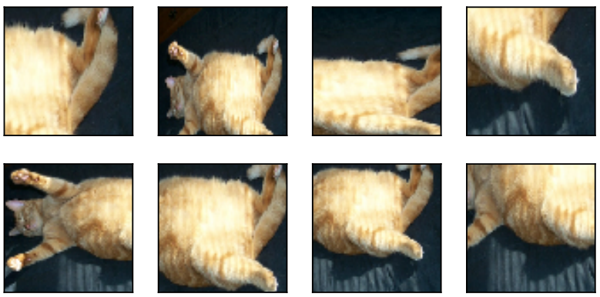
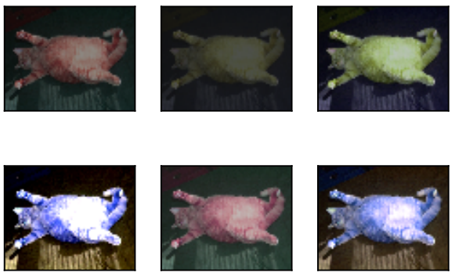
Convolutional Neural Networks
Important objectives to achieve in the design of a neural networks
Goals/Objectives
Avoid overfitting (“memorize” the training data)
Be able to generalize with new data
Yes, it's a cat!
Data is important
“I was not trained with images with different orientations, lighting, and positions.”
One of the best ways to control overfitting is to use more training data.

Slide 17
Convolutional Neural Networks
Important objectives to achieve in the design of a neural networks
Goals/Objectives
This is an optimization problem, and many hyper-parameters participate in the design of the neural network.
In addition, we can control overfitting by tuning the hyper-parameters according to the model to be developed.
so, the models learn and find convergence.
Layer size
Magnitude (learning rate)
Regularization (dropout)
Activations (activation function)
Weight initialization strategy
Loss functions
Settings for epochs during training
Normalization scheme for input data (vectorization)

Slide 18
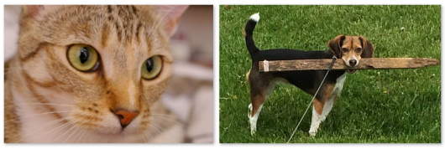
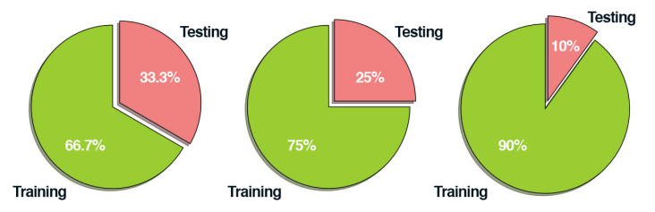
Convolutional Neural Networks
Classification Pipeline Process
The Process
A classic problem to classify a dog and a cat
Step #1: Gather your Dataset (Images and labels)
Step #2: Split your Dataset (training and testing set)
Step #3: Train Your Network
Step #4: Evaluate
Using test datasets only to evaluate your network

Slide 19
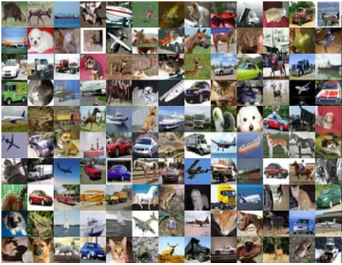
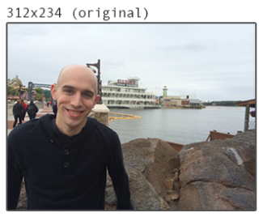
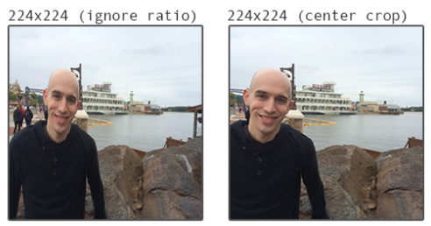
Convolutional Neural Networks
Image Pre-processor
Images must be preprocessed and scaled to have identical widths and heights.
To accomplish this resizing and scaling in some cases, ignoring the aspect ratio works just fine; in other cases, you’ll want to preserve the aspect ratio.
Organize the images
Common images sizes include 32 × 32, 64 × 64, 96 × 96, 224 × 224,
227 × 227 and 229 × 229.
/path/to/dataset/{class}/{image}.jpg

Slide 20
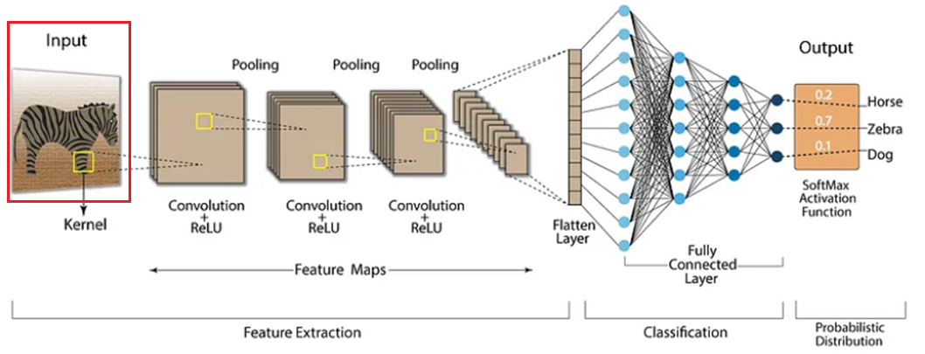
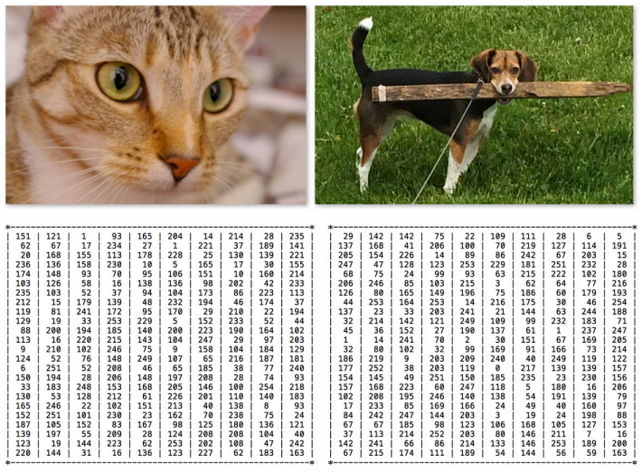
Convolutional Neural Networks
Input Layers
How does it work?
The image is transformed into a matrix of pixels for each channel.
Apply image normalization:
Pixel Normalization: scale pixel values from its current range (0-255) to the range 0-1, by dividing by 255.
Pixel Standardization: subtracting the mean from each pixel and dividing by the standard deviation of all the pixels.
This normalization makes the model train and reach a minimum error faster.
It’s been shown that dividing the training input dataset into mini-batches allows the training of the network more efficiently (32 – 1024).

Slide 21
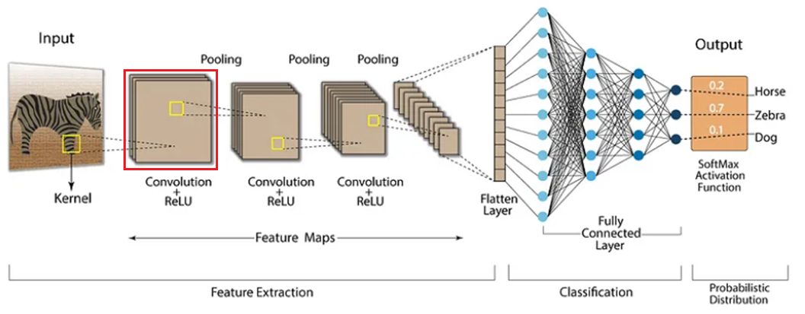
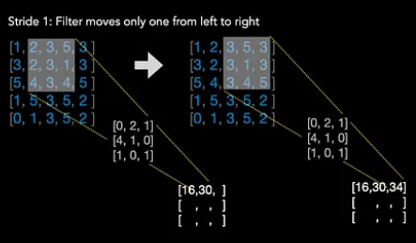
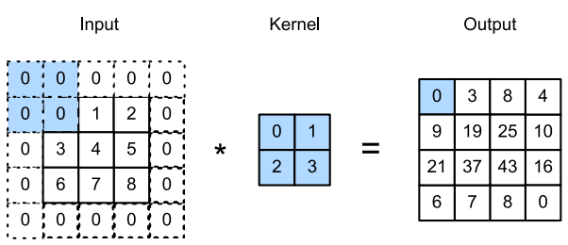
Convolutional Neural Networks
Convolutional Layers
How does it work?
hyper‐parameters: Filter size, Stride, and Padding.
Common filter sizes such as 3 × 3 and 5 × 5

Slide 22
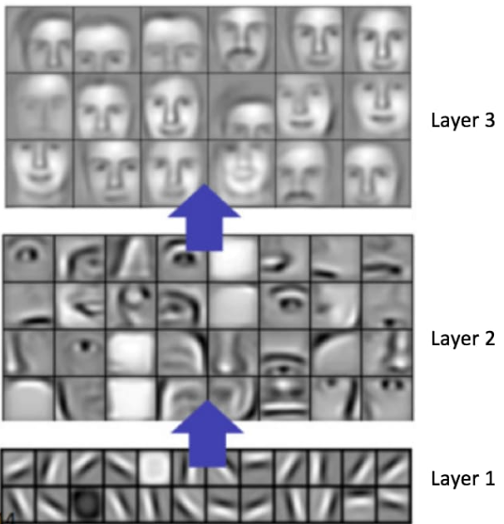
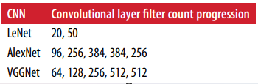
Convolutional Neural Networks
Filters and weights
How does it work?
Filters have the ability to extract complex patterns (features) that may involve interactions between different color channels (edges, textures, and the final object).
Weight initialization: they are set randomly, by sampling from a distribution with some variance (typically Gaussian or uniform).
It can greatly affect the training process.
If weights are too large, it can mean large outputs and large gradients, which can obviously have a detrimental effect during learning.
The weights of each filter are learned through backpropagation.

Slide 23
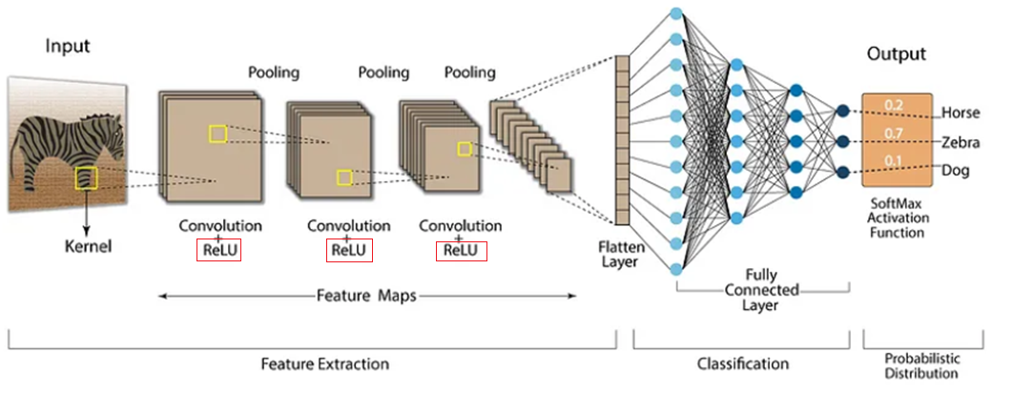
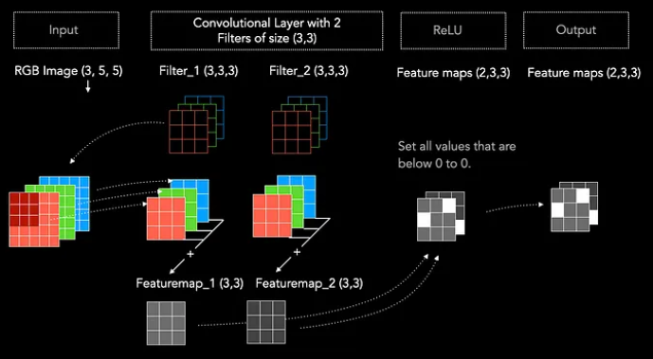
Convolutional Neural Networks
Activation function - Rectified Linear Unit
How does it work?
Activation functions help the model to learn certain types of features.
Ensure that the variance of network activations are constant for all layers.
Gradients don’t grow too large or small by the time they are backpropagated to the earlier network layers.
Activation maps are stacked together to form the output volume for the next layer.

Slide 24

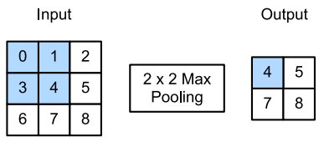
Convolutional Neural Networks
Pooling Layers
How does it work?
The primary function of the pool layer is to progressively reduce the spatial size (width and height) of the input volume.
a function that summarizes the most important information of the activation map.
Also, it reduces computation in the network and controls overfitting.
“sliding” the pooling window from left-to-right and top-to-bottom of the input array.

Slide 25
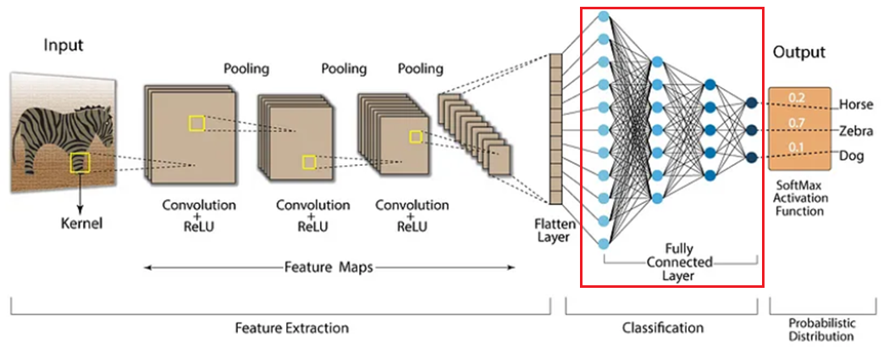
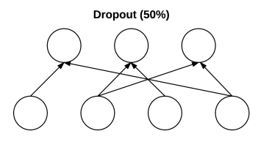
Convolutional Neural Networks
Fully-connected Layers - Regularization
How does it work?
Dropout
Helps our model to generalize and prevent overfitting.
Dropout is driven by randomly dropping a neuron so that it will not contribute to the forward pass and backpropagation.
Mute parts of the input to each layer, such that the neural network learns other portions.
Helps modify the gradient so that it doesn’t step in directions that lead it to overfit.

Slide 26
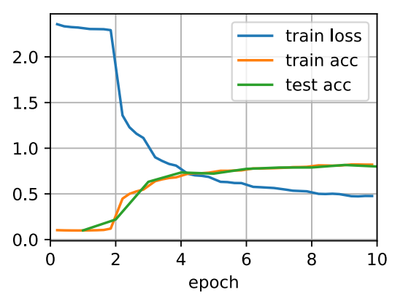
Convolutional Neural Networks
Fully-connected Layers - Loss functions
How does it work?
Used in the output layer.
Low value is good, high is bad. It drops over time.
Let the optimization function know how well it’s doing at Classification tasks.
Need to match them with both an appropriate activation function and the type of data/labels (extract features more effectively).
Squared loss
Logistic loss
Hinge loss
Negative log likelihood
Multiclass cross-entropy

Slide 27
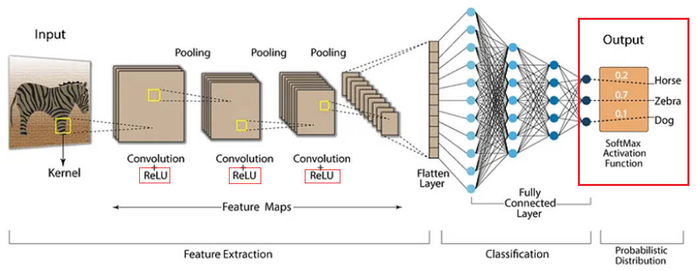
Convolutional Neural Networks
Fully-connected Layers – Output Classification
How does it work?
SoftMax Activation Function
Is a generalization of the Logistic Function, and it makes sure that our prediction add up to 1.
Apply an arg-max() function to get the highest score of all the classes.
The softmax output layer gives us a probability distribution over all the classes.

Slide 28
Dataset for Object Recognition
Top Best Public Datasets for Object Detection
Data is important
VGG Face (2.6 million face images)
ImageNet (14 million images, annotated in 20,000 categories)
CIFAR-10 (60,000 images in 10 classes)
CIFAR-100 (80 million images in 100 classes)
COCO (Microsoft Common Objects in Context) (330,000 images, annotated in 91 categories)
PASCAL VOC (1,464 images for training, 1,449 images for validation)
BDD100K (UCBerkeley "Deep Drive") (100,000 videos)

Slide 29

Demos
Face recognition demos
Let’s practice
1.- Simple face recognition on images using HAAR, HOG, and MTCNN
2.- Facial analysis recognition on images using DeepFace
3.- Facial landmarks on live Webcam
4.- Facial drowsiness detection using eyes landmarks
5.- Object detection using YOLO

Slide 30
References
A. M. TURING. "ON COMPUTABLE NUMBERS, WITH AN APPLICATION TO THE ENTSCHEIDUNGSPROBLEM". (1936, May 28). https://www.cs.virginia.edu/~robins/Turing_Paper_1936.pdf
Warren S. McCullough and Walter Pitts. "A Logical Calculus of the ideas Imminent in Nervous Activity". (1943). https://home.csulb.edu/~cwallis/382/readings/482/mccolloch.logical.calculus.ideas.1943.pdf
When Machine Learning Was First Coined: A Brief History. (2023, Jun 22). ticktocktech . https://ticktocktech.com/blog/2023/06/22/when-machine-learning-was-first-coined-a-brief-history/
What is machine learning?. (n.d). IBM . https://www.ibm.com/topics/machine-learning
What is machine learning and how does it work? In-depth guide. (n.d). TechTarget. https://www.techtarget.com/searchenterpriseai/definition/machine-learning-ML
Understanding Feedforward Neural Networks. (n.d). Learn OpenCV. https://learnopencv.com/understanding-feedforward-neural-networks/
How Does Backpropagation in a Neural Network Work?. (2023, Aug 07). Builtin. https://builtin.com/machine-learning/backpropagation-neural-network
Backpropagation From mystery to mastery: Decoding the engine behind Neural Networks. (2023, Nov 1). Medium. https://pub.towardsai.net/backpropagation-2eeb25201095
What is Deep Learning and How Does It Works. (2023, Aug 29). simplilearn . https://www.simplilearn.com/tutorials/deep-learning-tutorial/what-is-deep-learning
Convolutional Neural Networks: A Deep Dive (2024). (n.d). viso.ai . https://viso.ai/deep-learning/convolutional-neural-networks/https://viso.ai/deep-learning/convolutional-neural-networks/
Object Detection in 2024: The Definitive Guide. (n.d). viso.ai . https://viso.ai/deep-learning/object-detection/https://viso.ai/deep-learning/object-detection/
Cascade Classifier. (n.d). OpenCV. https://docs.opencv.org/3.4/db/d28/tutorial_cascade_classifier.html
Histogram of Oriented Gradients and Object Detection. (2014, Nov 10). Pyimagesearch. https://pyimagesearch.com/2014/11/10/histogram-oriented-gradients-object-detection/
Paul Viola and Michael Jones. “Rapid Object Detection using a Boosted Cascade of Simple Features”. (2001). https://www.cs.cmu.edu/~efros/courses/LBMV07/Papers/viola-cvpr-01.pdf

Slide 31
References
Dalal and Triggs. “Histogram of Oriented Gradients for Human Detection”. (2005). https://lear.inrialpes.fr/people/triggs/pubs/Dalal-cvpr05.pdf
Pedro F. Felzenszwalb, Ross B. Girshick, David McAllester and Deva Ramanan. “Object Detection with Discriminatively Trained PartBased Models“. (2009). https://cs.brown.edu/people/pfelzens/papers/lsvm-pami.pdf
Ross Girshick, Jeff Donahue, Trevor Darrell, and Jitendra Malik’. “Rich feature hierarchies for accurate object detection and semantic segmentation”. (2014). https://arxiv.org/pdf/1311.2524v5.pdf
Shaoqing Ren, Kaiming He, Ross Girshick, and Jian Sun. “Faster R-CNN: Towards Real-Time Object Detection with Region Proposal Networks”. (2015). https://arxiv.org/pdf/1506.01497.pdf
Kaiming He, Georgia Gkioxari, Piotr Dollár, and Ross Girshick. “Mask R-CNN”. (2017). https://arxiv.org/pdf/1703.06870.pdf
Tsung-Yi Lin, Piotr Dollár, Ross Girshick, Kaiming He, Bharath Hariharan, and Serge Belongie. “Feature Pyramid Networks for Object Detection”. (2017). https://arxiv.org/pdf/1612.03144.pdf
Joseph Redmon, Santosh Divvala, Ross Girshick, and Ali Farhadi’s. “You Only Look Once: Unified, Real-Time Object Detection”. (2016). https://arxiv.org/pdf/1506.02640.pdf
Wei Liu, Dragomir Anguelov, Dumitru Erhan, Christian Szegedy, Scott Reed, Cheng-Yang Fu, and Alexander C. Berg. “SSD: Single Shot MultiBox Detector”. (2016). https://arxiv.org/pdf/1512.02325.pdf
Dillon Reis, Jordan Kupec, Jacqueline Hong, and Ahmad Daoudi. “Real-Time Flying Object Detection with YOLOv8”. (2023). https://arxiv.org/pdf/2305.09972.pdf
Tsung-Yi Lin, Priya Goyal, Ross Girshick, Kaiming He, Piotr Dollár. “Focal Loss for Dense Object Detection”. (2018). https://arxiv.org/pdf/1708.02002.pdf
Kaipeng Zhang, Zhanpeng Zhang, Zhifeng Li, Yu Qiao. "Joint Face Detection and Alignment using Multi-task Cascaded Convolutional Networks". (2016). https://arxiv.org/ftp/arxiv/papers/1604/1604.02878.pdf
VGG Face Dataset. (n.d). VGG University of Oxford. https://www.robots.ox.ac.uk/~vgg/data/vgg_face/
ImageNet. (2021, Mar 11). image-net.org. https://www.image-net.org/
CIFAR-10 and CIFAR-100. (n.d). https://www.cs.toronto.edu/~kriz/cifar.html
Microsoft COCO. (n.d). Common Object in Context. https://cocodataset.org/#home
PASCAL VOC. (n.d). http://host.robots.ox.ac.uk/pascal/VOC/
BDD100K (UCBerkeley "Deep Drive"). (n.d). DB100K. https://doc.bdd100k.com/license.html
The 10 Best Public Datasets for Object Detection in 2022. (n.d). scale. https://scale.com/blog/best-10-public-datasets-object-detection

Slide 32
References
Object Detection Datasets. (n.d). Roboflow. https://public.roboflow.com/object-detection
Haar Cascades models Repo. (n.d). Github. https://github.com/opencv/opencv/tree/master/data/haarcascades
Histogram of Oriented Gradients explained using OpenCV. (2016, Dec 6). LearnOpenCV. https://learnopencv.com/histogram-of-oriented-gradients/
MTCNN-OpenCV. (2021, Jan 5). pypi.org. https://pypi.org/project/mtcnn-opencv/
Yaniv Taigman, Ming Yang, Marc’AurelioRanzato, LiorWolf. (2014). "DeepFace: Closing the Gap to Human-Level Performance in Face Verification". https://www.cs.toronto.edu/~ranzato/publications/taigman_cvpr14.pdf
DeepFace. (n.d). Github. https://github.com/swghosh/DeepFace
deepface. (2020, May 25). pypi.org. https://pypi.org/project/deepface/0.0.24/
Google Colaboratory. (n.d). Colab. https://colab.research.google.com/
Model Prediction with Ultralytics YOLO. (n.d). Ultralytics .https://docs.ultralytics.com/modes/predict/
scikit-learn Machine Learning in Python. (n.d). scikit-learn. https://scikit-learn.org/stable/
Dlib C++ Library. (n.d). Dlib. http://dlib.net
OpenCV. (n.d). Opencv. https://opencv.org
TensorFlow. (n.d). Tensorflow. https://www.tensorflow.org
PyTorch. (n.d). Pytorch. https://pytorch.org
Keras. (n.d). keras. https://keras.io
Apache mxnet a Flexible and Efficient Library for Deep Learning. (n.d). mxnet. https://mxnet.apache.org/versions/1.9.1/
Caffe Deep learning framework. (n.d). caffe. https://caffe.berkeleyvision.org

